Slide 1
Week 10B
CPE 487 Digital System Design
Darian Muresan
dmuresan@stevens.edu
© 2020 Stevens Institute of Technology. All Rights Reserved.

Slide 2
Agenda
Recap Nexys A7™ FPGA Board Analysis
Recap Moore and Mealy State Machines
Diagraming and Schematic Tools
Digi-Key Parts
2

Slide 3
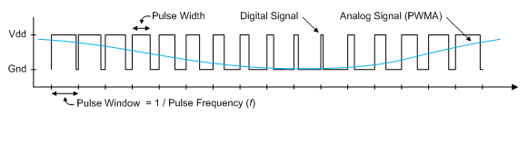
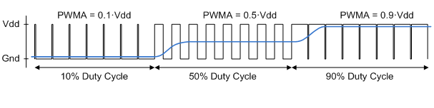
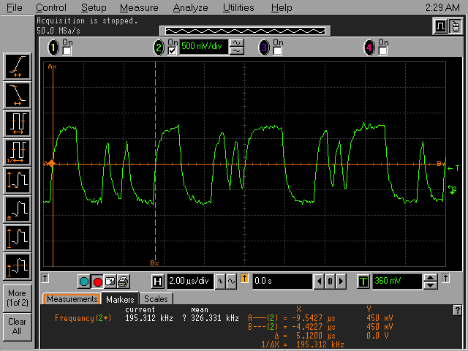
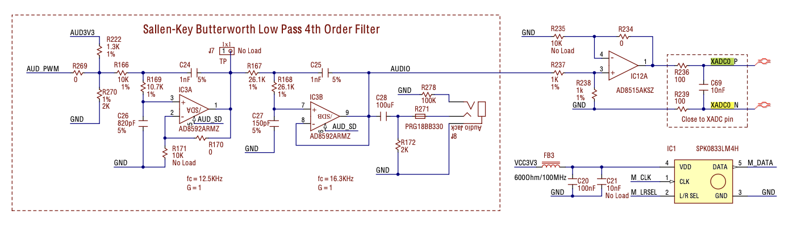

Pulse Density Modulation
3

Slide 4
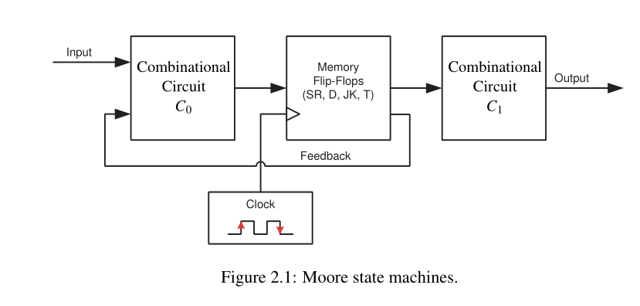
Moore State Machines
4

Slide 5
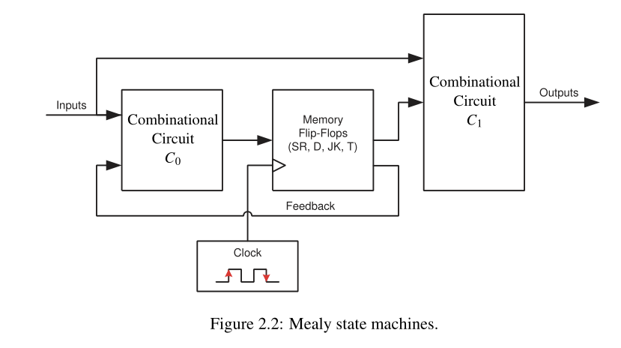
Mealy State Machines
5

Slide 6
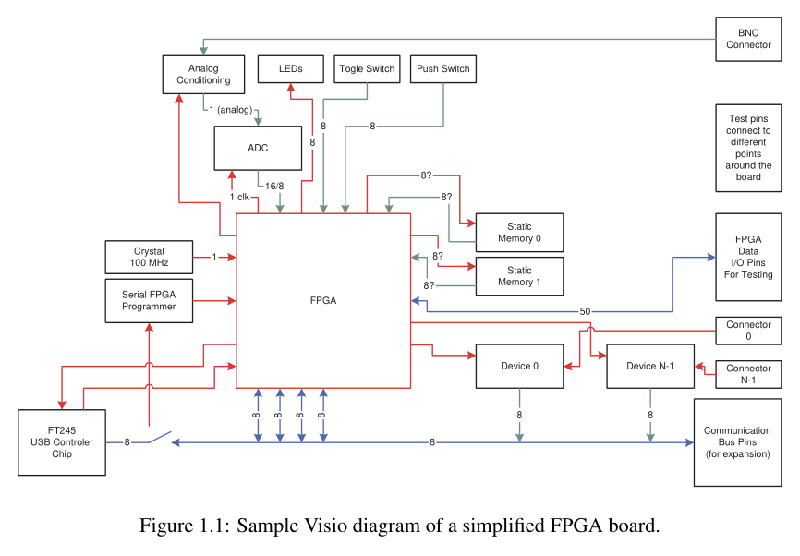
Diagrams with Visio
Part of Microsoft Office
Electronic and digital parts stencils available.
Good for high level documentation.
6

Slide 7

Schematics with OrCAD and Allegro
Professional schematics and PCB design cad
Available with all types of extensions, including PSpice simulation
Students can obtain one year license for free, with student ID.
https://www.ema-eda.com/products/cadence-orcad/orcad-academic-program
Maintenance cost is about $500/year for small businesses
7

Slide 8
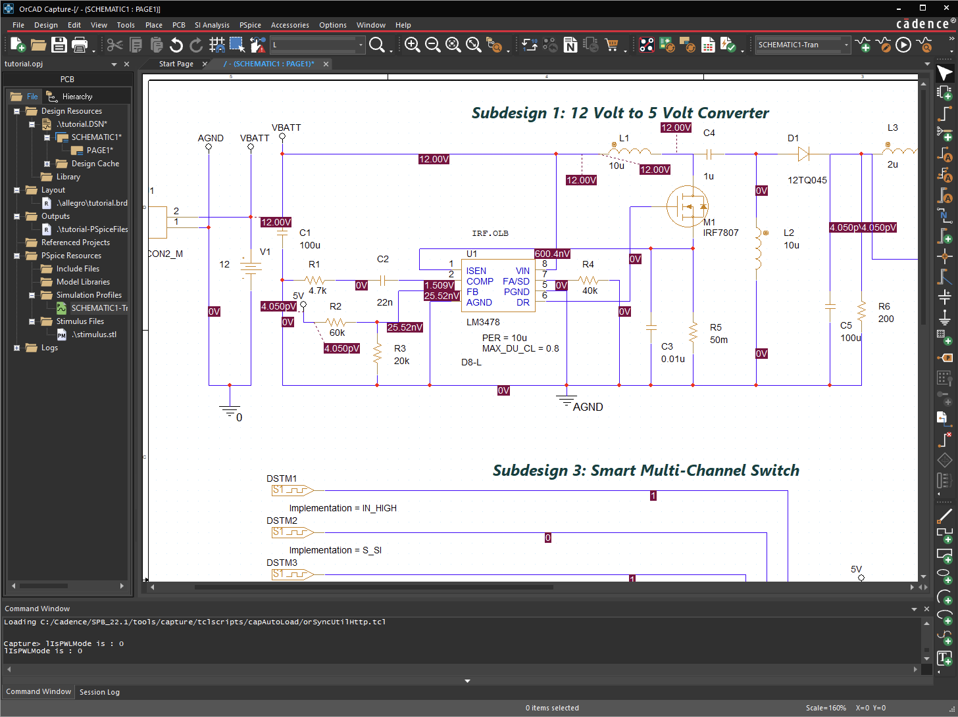
Schematics with OrCAD and Allegro
8

Slide 9
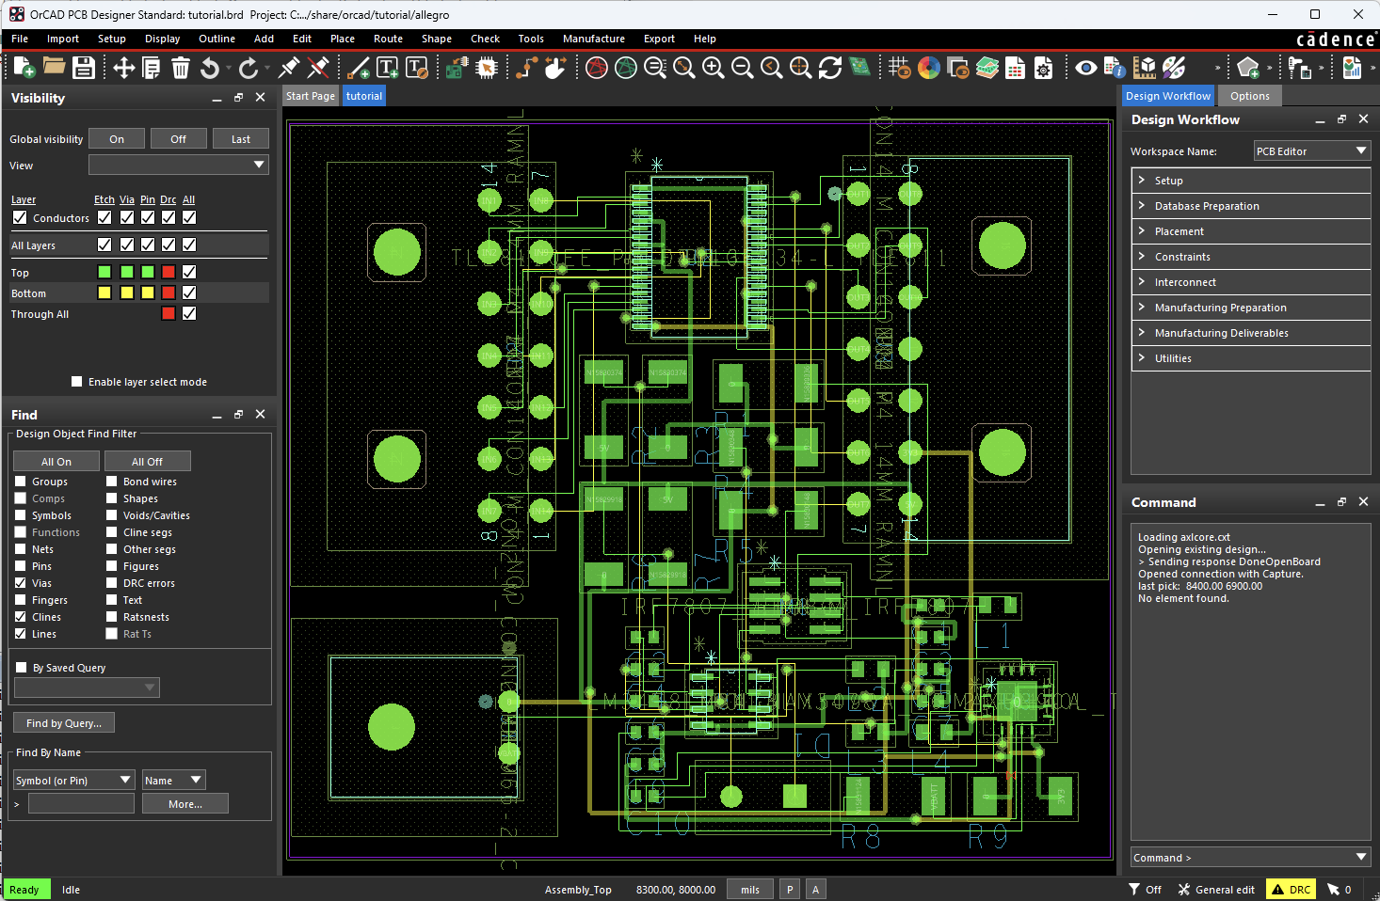
Schematics with OrCAD and Allegro
9

Slide 10
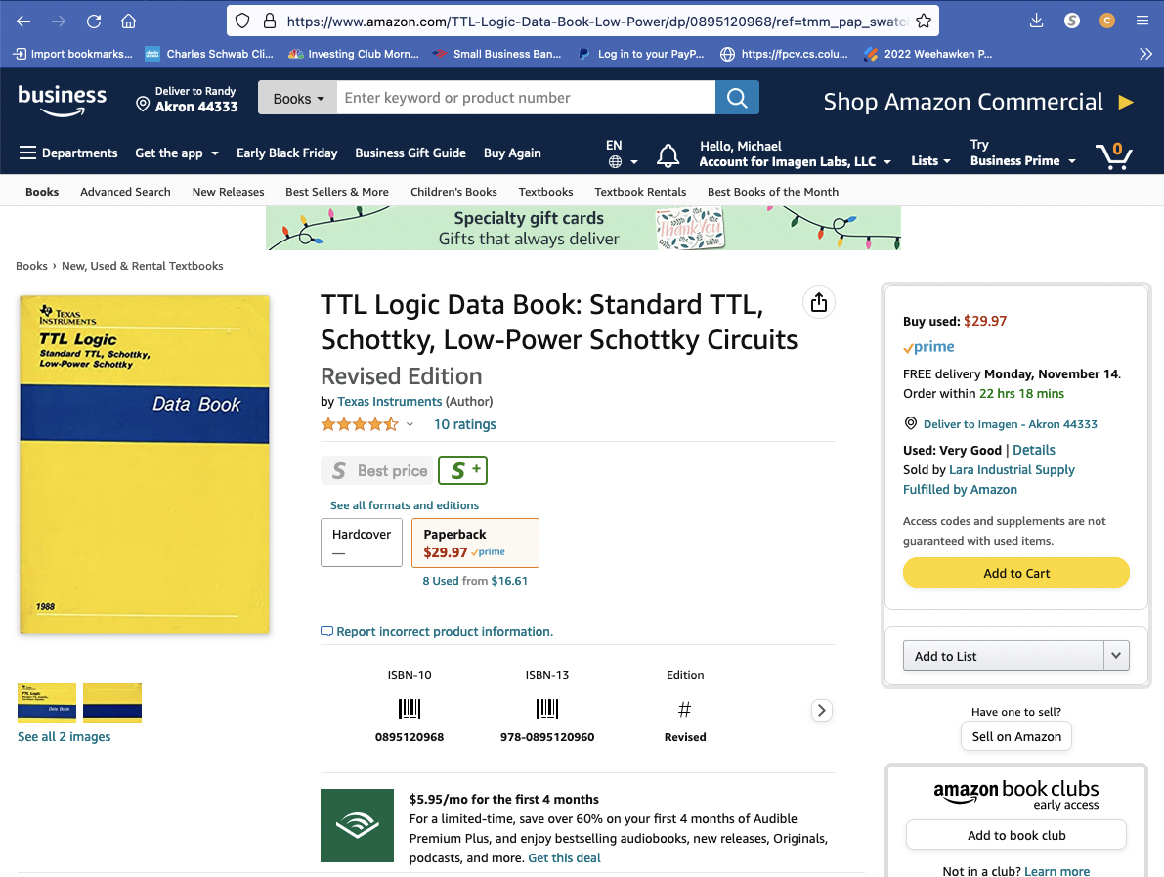
TTL Logic Data Book
Excellent TTL Data Book
Great source for learning the TTL 7400 family of chips.
https://www.amazon.com/TTL-Logic-Data-Book-Low-Power/dp/0895120968/ref=tmm_pap_swatch_0?_encoding=UTF8&qid=&sr=

Slide 11
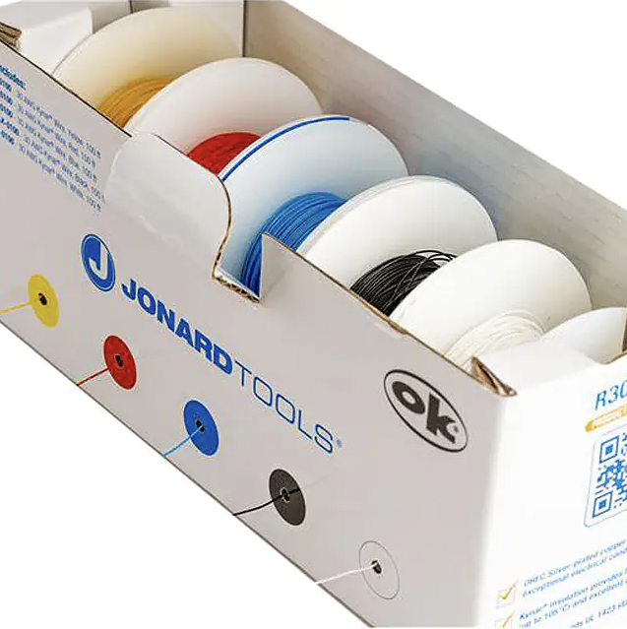

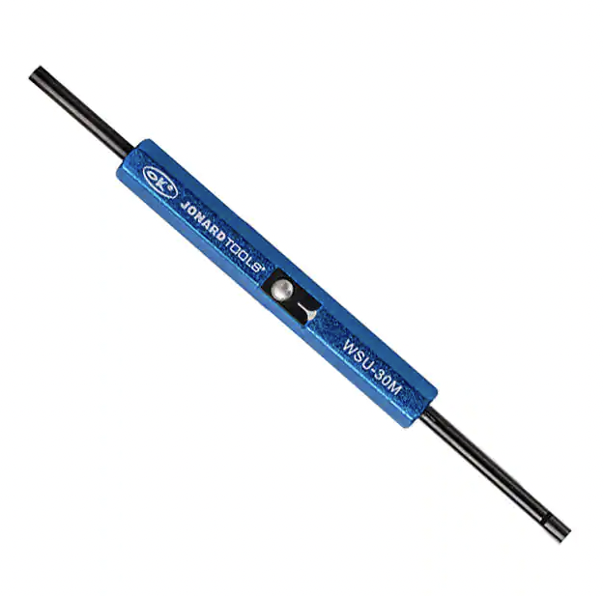
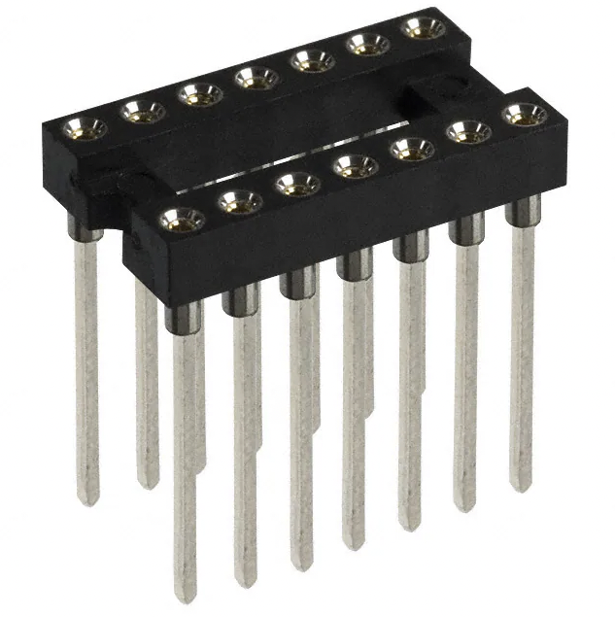
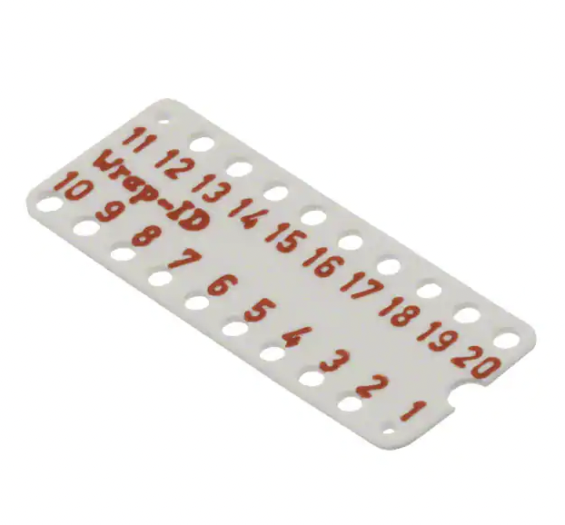
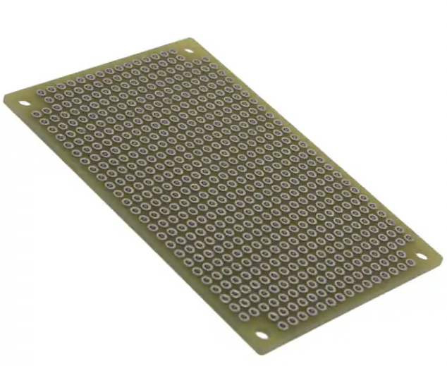
Digi-Key Source of Electronics and Parts (https://www.digikey.com/)
Search: wire wrap wires (28 AWG or 30 AWG)
Search: wire wrap gun
Search: wire wrap tools
Search: wire wrap sockets
Search: socket labels
Search: prototype boards perforated

Slide 12
Misc. Slides
12

Slide 13
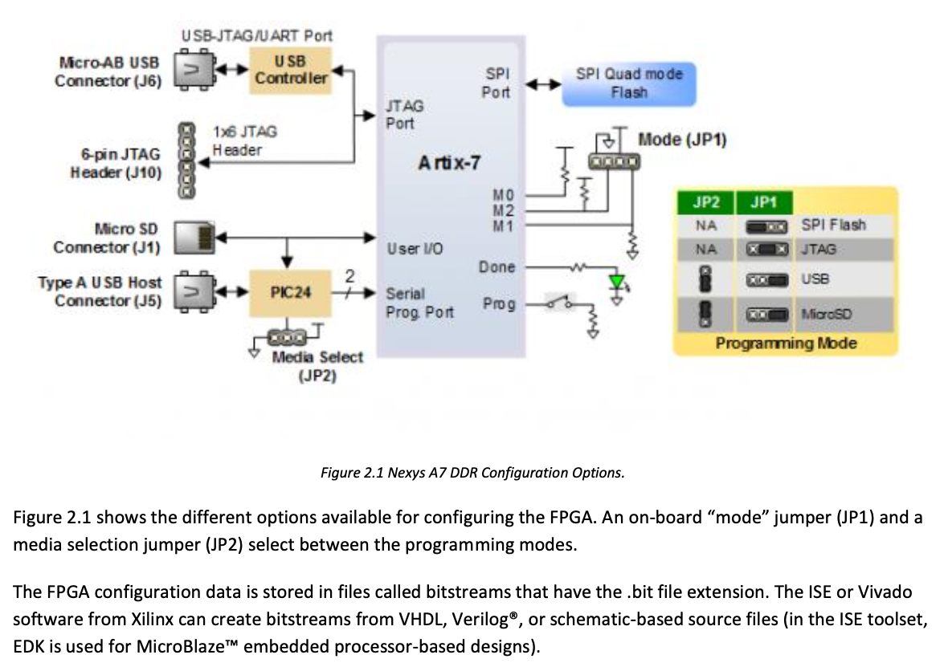
Programming the FPGA
13

Slide 14
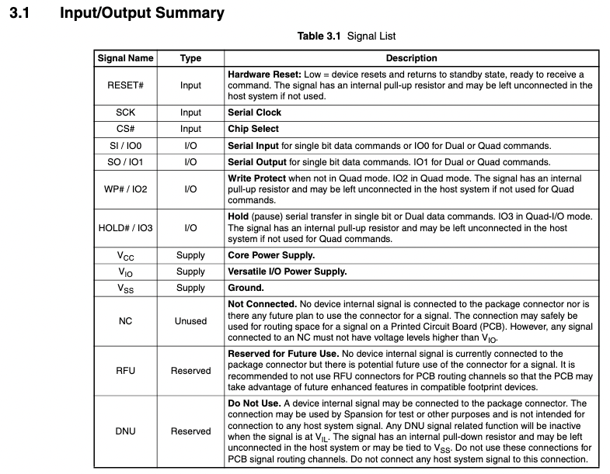
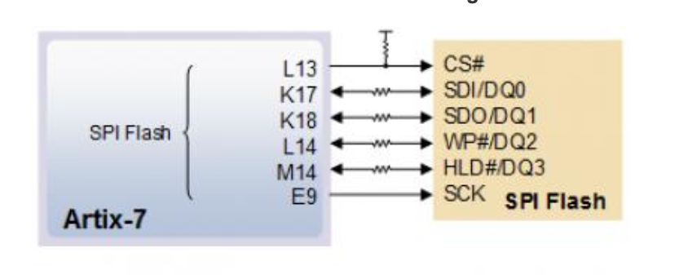

Programming the FPGA
14

Slide 15
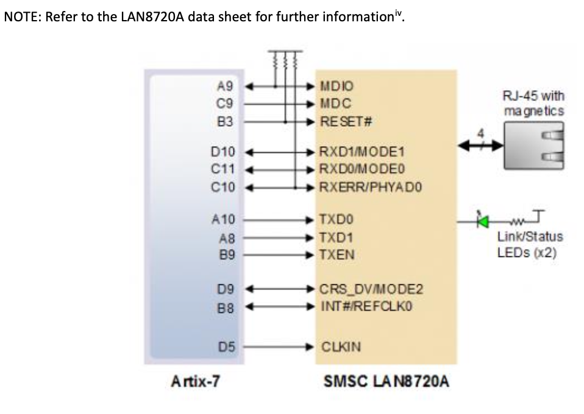
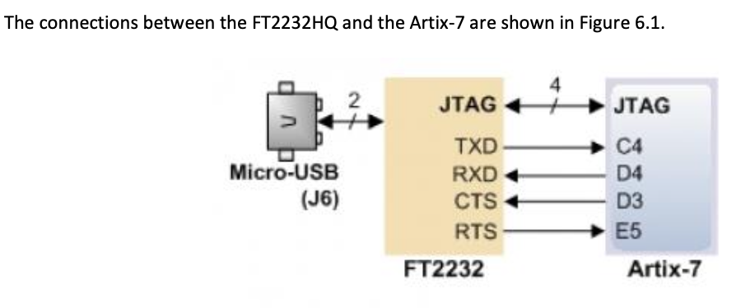
The FPGA Data Connection
15

